Slide 1
Creative Coding 2
Introduction to Data Visualisation

Slide 2
Summary
The aim of data visualisation is to effectively communicate information through a graphical means.
This section of the module aims to provide an introduction to data and how best to create effective graphical representations of data using the relevant tools and techniques.

Slide 3
What Makes ‘Good’ Data Visualisation?
Best practice in data visualisation is based on good design principles, combined with an understanding of the data being used.
What helps us to create useful visualisations that “tell a story”?
A knowledge of the history and theory of data visualisation;
An ability to analyse existing visualisations and to understand why they work (or not);
An awareness of the purpose of the visualisation;
An awareness of the intended audience.

Slide 4
Data
People have always been collecting, tabulating and quantifying data.
However the last few years have seen a growing interest in data visualisation due to a number of factors, including:
Improvements in technology.
Now easier to collect and store data.
More and more data available to us.
More data is thrown at us in one day than someone living in the middle ages received in their whole lifetime!

Slide 5
Data
More official (and better formatted) government (local and countrywide) data available
Data.gov.ie (Ireland), Data.gov (U.S.) Data.gov.uk (U.K.)
Dublinked (data.smartdublin.ie)
Data is more accessible because of the web
APIs enable developers to do something with all the data
Twitter, Flickr (photo sharing and management), Infochimps (cloud services for big data), Factual/Foursquare (location data).
More personal information out there
Twitter, Facebook etc., apps that log how much exercise we take etc.

Slide 6
Aside: What is an API?
An Application Programming Interface (or API) is a software intermediary that allows two apps to talk to each other operating through a set of rules and protocols.
Web API Example:
When you sign into Facebook from your phone, you are telling the Facebook application that you would like to access your account. The mobile app makes a call to an API to retrieve your Facebook account and credentials. Facebook would then access this information from one of its servers and return the data to the mobile app.

Slide 7
Traditional Data

Slide 8
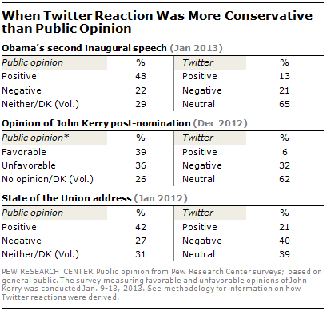
Twitter Data

Slide 9
Data
By 2025, there will be 175 zettabytes (equal to one sextillion bytes or a trillion gigabytes!) of data in the global datasphere
The amount of data in the world was estimated to be 44 zettabytes at the dawn of 2020.
By 2025, the amount of data generated each day is expected to reach 463 exabytes (one billion gigabytes!) globally.

Slide 10
Data
Google, Facebook, Microsoft, and Amazon store at least 1,200 petabytes (one million gigabytes!) of information.
a petabyte is the equivalent of 20 million tall filing cabinets or 500 billion pages of standard printed text!
Google receives 5.6 billion search requests per day.

Slide 11
Data
This data comes from everywhere: sensors used to gather climate information, posts to social media sites, digital pictures and videos, purchase transaction records, and cell phone GPS signals to name a few (IBM, 2013).

Slide 12
Data & Cities
An increasingly amount of this data stream is geolocated, from check-ins via Foursquare through to Tweets and searches via Google
Now, the data that cities and individuals emit can be collected and viewed to make the data city visible, aiding our understanding of now only how urban systems operate but opening up the possibility of a real-time view of the city at large (Hudson-Smith, 2013).

Slide 13
Data & Cities
The development of systems such as www.dublindashboard.ie (Dublin), www.citydashboard.org (London) and the rise of the Internet of Things (IoT) in terms of data collection, visualization and analysis.
Dublindashboard.ie aggregates simple spatial data for cities and displays the data on a dashboard and a map.
The Smart City, The Smart Citizen, Crowd Sourcing etc.

Slide 14
Irish Examples

Slide 15
CityWatch
CityWatch is (was?) Collaborative Research project between Trinity College Dublin, Intel Labs Europe & Dublin City Council , exploring themes such as: Citizen-Enabled Sensor Networks, Cities Informing Its Citizens, Gamification and Incentivization and Civic Engagement.
CityWatch explores how citizen contributed sensor data in combination with data from sensors deployed by municipals and utilities can be used to make cities sustainable and connected.
Not currently active?

Slide 16
FixMyStreet
FixMyStreet.ie is an online service provided by the County Councils for the reporting of problems in the public realm to your Local Authority.
FixMyStreet.ie started as a pilot project in South Dublin in 2011 and was rolled out nationally during 2012.
The service is geo-aware; it will forward reports received to the relevant Local Authority.
FixMyStreet.ie is built on the open source Ushahidi platform and is centrally hosted.
Ushahidi is a tool for collecting, managing and visualising data

Slide 17
FixMyStreet has an open API meaning many other geo-reporting services can ‘plug into’ it and also the data captured can be easily accessed via the open API.

Slide 18
Visualising This Data
Need to try and make sense of all this data.
Data representing the physical world (a table of numbers?) -> analyse that data to find out what’s going on around you -> information
Visualisation can help with this process.
Visualisation aims - varied:
Patterns aid analysis.
The entertainment factor (Figures 1 and 2).
Vehicle to
Communicate ideas
Tell a story
Solve a problem.

Slide 19
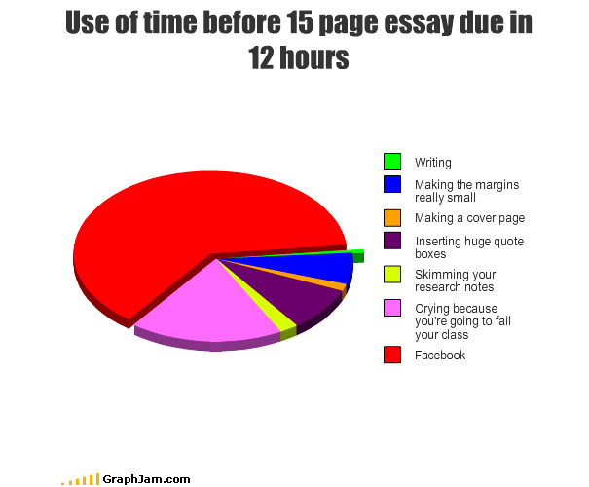
Figure 1

Slide 20
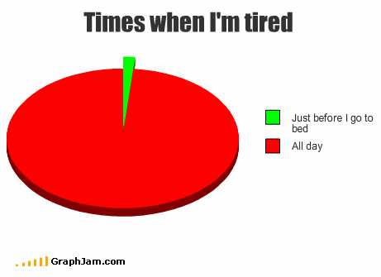
Figure 2

Slide 21
Example – US Unemployment Rate
In 2009, the U.S. experienced a significant increase in its unemployment rate.
In 2007, the national average was 4.6 percent, in 2008 it had risen to 5.8 percent, by September 2009, it was 9.8 percent.
This percentages generalise over the whole country.
Doesn’t tell us whether some regions were affected more than others.

Slide 22
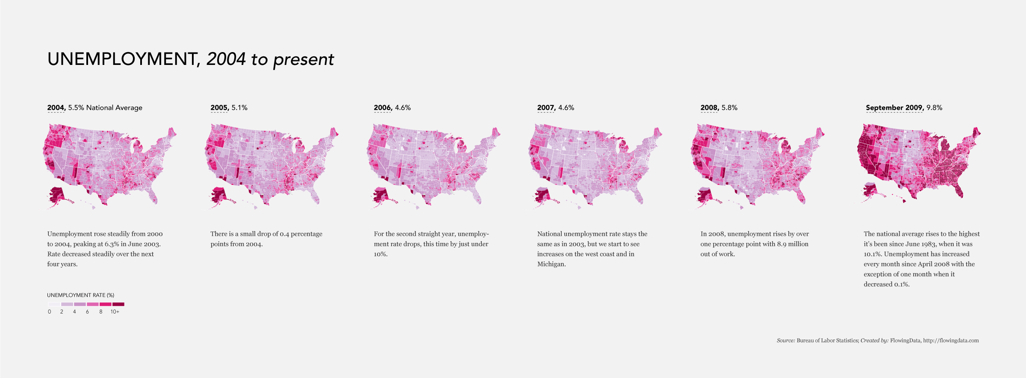
Figure 3

Slide 23
Example – US Unemployment Rate
The maps (Figure 3) tell a more complete story at a glance:
Darker coloured countries had relatively higher unemployment rates, whereas lighter colours signified lower rates.
For example, areas in the Midwest were not hit as hard as the West.
Can aid policy makers?
Data is free and publicly available from the Bureau of Labor Statistics.

Slide 24
What is Visualisation?
Traditional graphs and charts?
Anything that displays data?
Looking for the truth.
Lies often inadvertent due to bad visualisation techniques.
Chart junk.

Slide 25
Chart Junk
Chart (or data) junk is defined as unnecessary visual elements and decorations that make the visualisation more difficult to understand, and even misleading.
The term was originated by Edward Tufte - see next week - who considers that anything in a chart that does not represent data (or is a scale or label) is unnecessary and distracting, and can actually be harmful.
Nigel Holmes (British graphic designer who has a focus on information design) has a different view and says that the graphic “must engage the reader’s interest”
-> ongoing debate.

Slide 26
Edward Tufte
American statistician, artist, Professor at Yale who wrote one of the definitive books on statistical graphics, charts, tables
The Visual Display of Quantitative Information

Slide 27
Chart Junk Examples
3d visualisations of 2d data.
Textures and gradients.
Illustrations as data – especially if not in proportion (see Figure 4)
Background illustrations or photographs.
Additional non-essential information.
Disregarding conventions – e.g. a bar chart with tilted or inverted bars.

Slide 28
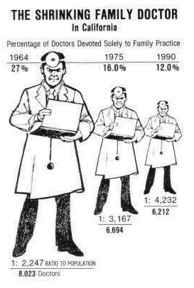
Figure 4
Notes:
The scale of the graphic doesn’t correspond to changes in the data being represented
Overlaid perspective
Incorrect horizontal spacing

Slide 29
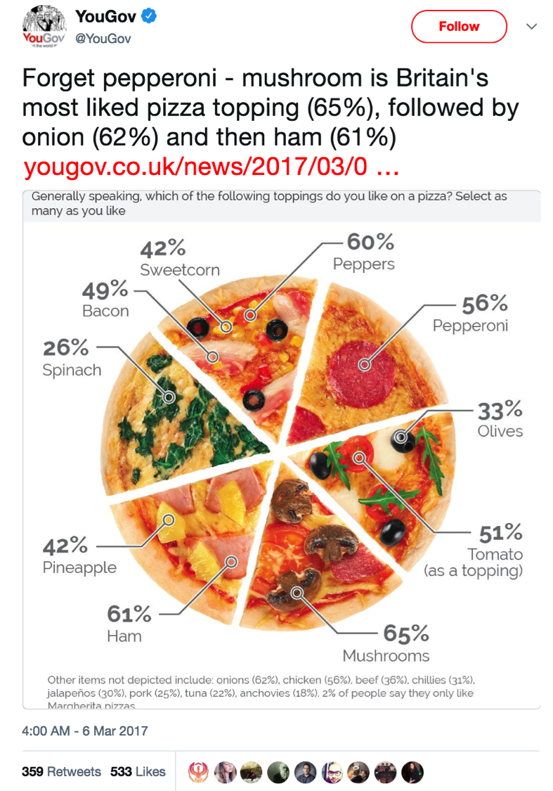
Figure 5 - Good or Bad Graphic?

Slide 30
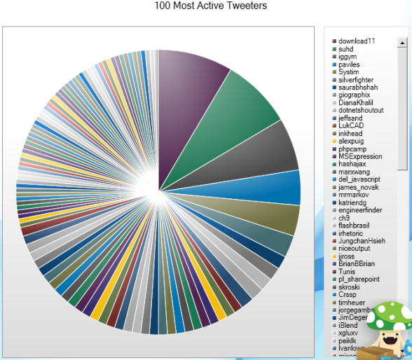
Figure 6 - Good or Bad Graphic?

Slide 31
Pie Charts!
https://visuanalyze.wordpress.com/2013/02/05/bad_piecharts/

Slide 32
Example – Probability of Death Within One Year
The graphic from the New York Times (Figure 7) shows the increasing probability that you will die within one year given your age.
The base of the graphic is simply a line chart.
However design elements help such as labelling and pointers provide context and help the viewer see why the data is interesting.
Line width and colour direct your eye to what is important.
This is an example of a visualisation that presents the data and gives you the facts.

Slide 33
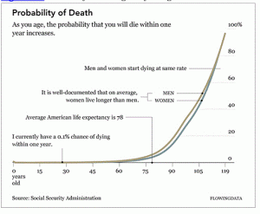
Figure 7

Slide 34
Art
Jonathan Harris and Sep Kamvar (http://wefeelfine.org) created an interactive particle system that scrapes sentences and phrases from personal public blogs and then visualises them as a box of floating bubbles.
Each bubble represents an emotion and is colour-coded accordingly.
The viewer can apply sorts and categorisations through the interface to see how these seemingly random descriptions connect – offering responses to questions like: Do Europeans feel sad more often than Americans? What are the happiest cities in the world? Etc.
Click an individual bubble to see a single story.
Not currently active?

Slide 35
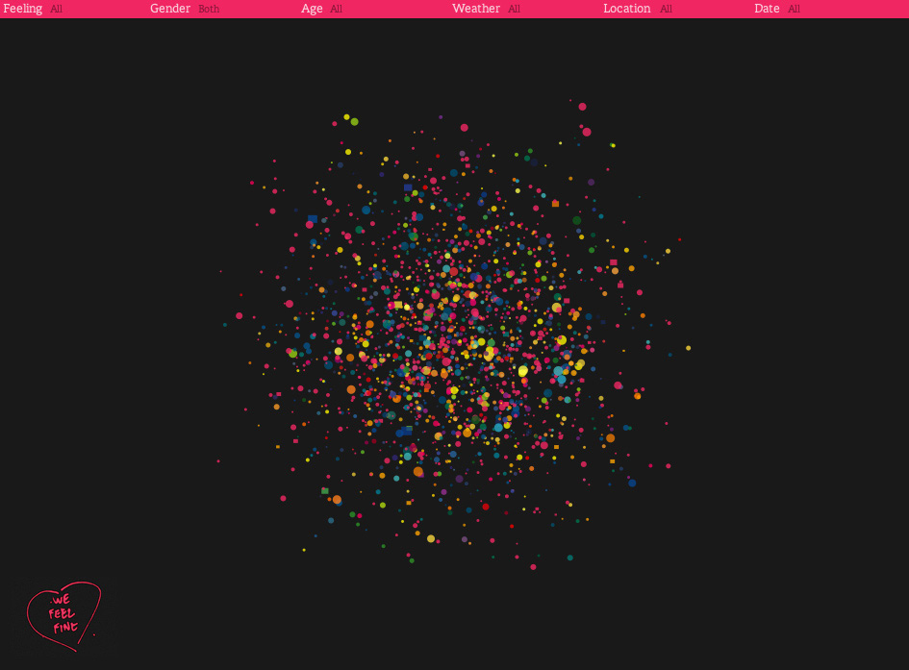

Figure 8

Slide 36
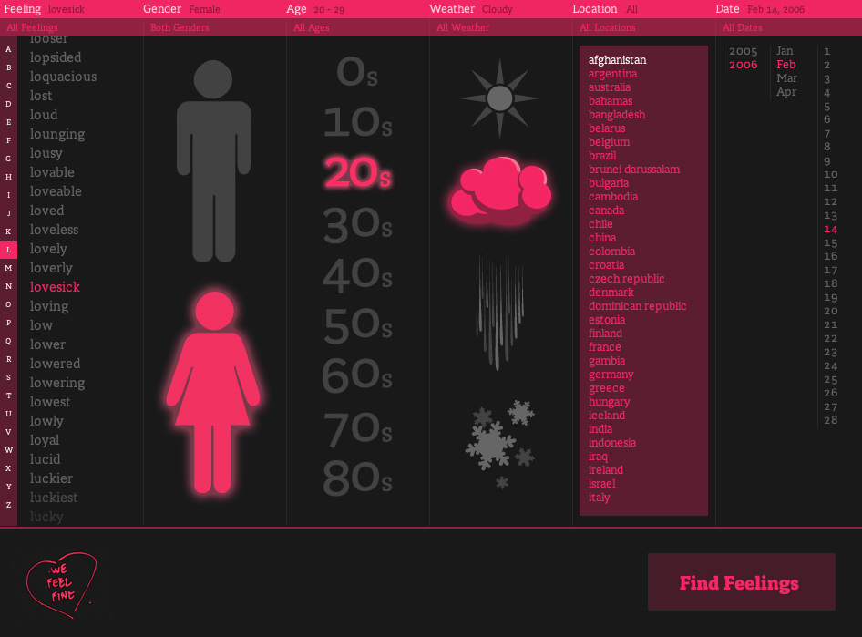
Figure 9

Slide 37
Entertainment
Facebook used status updates to gauge the happiest day of the year.
Online dating site OkCupid used online information to estimate the lies people tell to make them look better
(Figure 10).

Slide 38
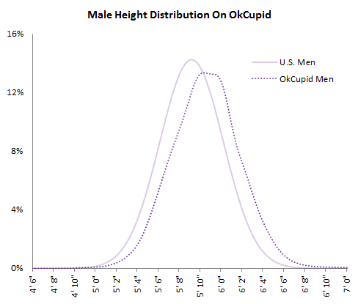
Figure 10
Notes:
OKCupid men taller?

Slide 39
Hans Rosling
Using a tool called Trendalyzer (Figure 11), Hans Rosling, Professor of International Health and director of the Gapminder Foundation, runs an animation that shows changes in poverty by country (http://www.ted.com/talks/hans_rosling_shows_the_best_stats_you_ve_ever_seen?language=en)

Slide 40
The visualisation is a motion chart.
Bubbles represent countries and move based on the corresponding country’s poverty during a given year.
He also tells the story behind the data.

Slide 41
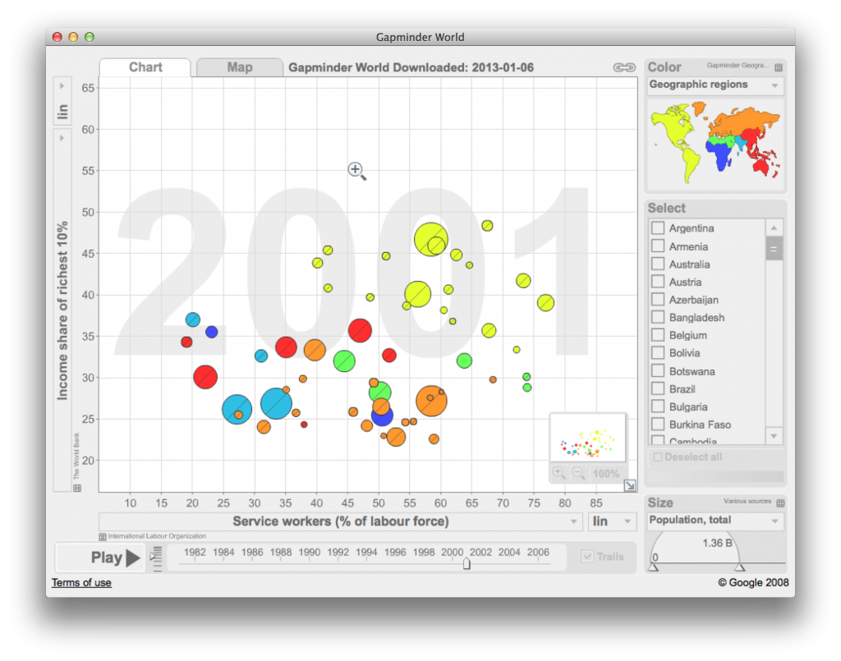
Figure 11

Slide 42
Exploring Data – What Graph to Use?
For example, say you are interested in stock prices over time.
They increase and decrease, but by how much do they change per day, per week etc.?
Are there periods when the stock went up more than usual, and if so, why?
Did any particular events trigger this change?
Time series is a useful tool for those sort of questions.
Other questions might be better explored by looking at patterns over geographic regions for example.

Slide 43
Time Series - Patterns Over Time
You can split your time series in different ways.
For example hourly or daily values.
Time series shows more noise – graph is bumpier.
Or on a monthly or annual basis.
An aggregate view – graph is smoother as fewer data points over the same time span.

Slide 44
Relationships
You can design graphics to compare and contrast values and distributions visually.
The statistical equivalent is correlation and causation (https://www.tylervigen.com/spurious-correlations)
Multiple variables/datasets might be related in some way.

Slide 45
Example
The following Technology excerpt from World Progress Report (Figure 12) includes histograms that show the number of users of the Internet, Internet subscriptions, and broadband per 100 inhabitants.
Notice that the range for Internet users (0 to 95 per 100 inhabitants) is much wider than that of the other two datasets.
However each histogram was made on the same range to aid comparison between distributions.

Slide 46
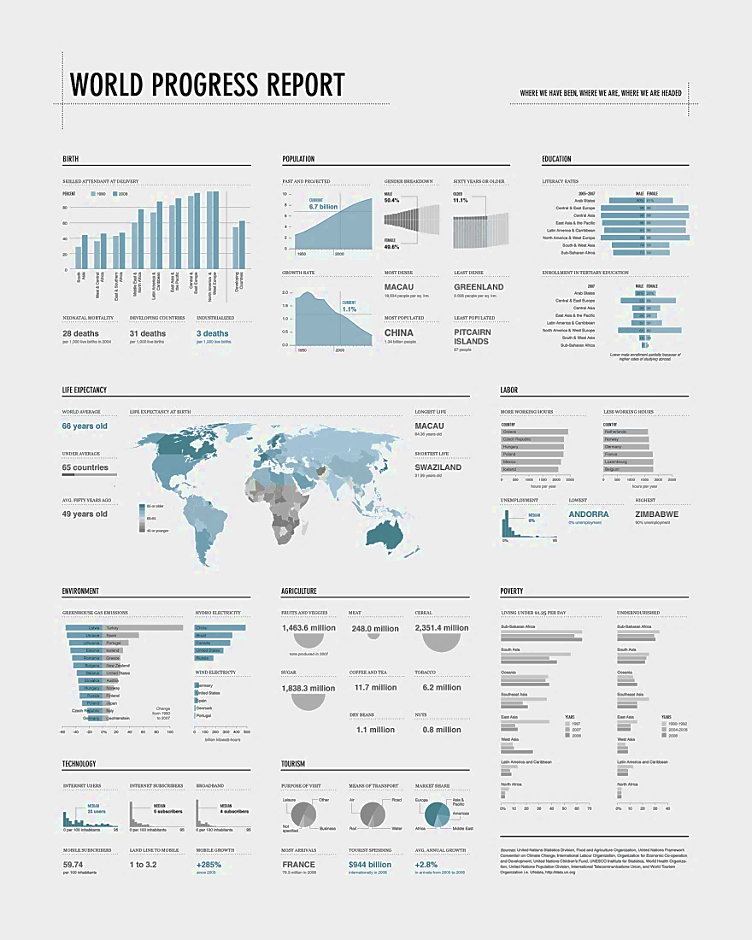
Figure 12

Slide 47
Rules
Finally, when deciding to visualise data of interest, there are certain basic rules that should be followed.
Note that we would be looking at more formal rules called processes (Fry, Shapiro etc.). later on in the module if we had more time.

Slide 48
Graphics Checksheet
Verify your data before using it.
If graphic looks wrong – check again. It could be an error or it could be an outlier.
Explain all encodings (circles, bars, colours) so that viewers can decode easily. Use labels, legends, keys.
For example, the colour grading in Figure 13 doesn’t make much sense without a legend.
Label your axes so that readers know what scale the points are plotted on – incremental, logarithmic, exponential (Figures 14, 15, 16).
Include your sources.
Consider your audience and the purpose of your graphics.
For example, analysis for a mass audience, a business report etc.

Slide 49
The shapes you use should be in proportion.
The length of rectangles in a bar graph represent values;
The position indicates value in a dot plot or time series;
Pie charts use angles, and the sum should add to one hundred percent.
When using two dimensional shapes, size them accordingly.
When you create a bubble chart, use an area to represent values, not radius or diameter (Figure 17).

Slide 50
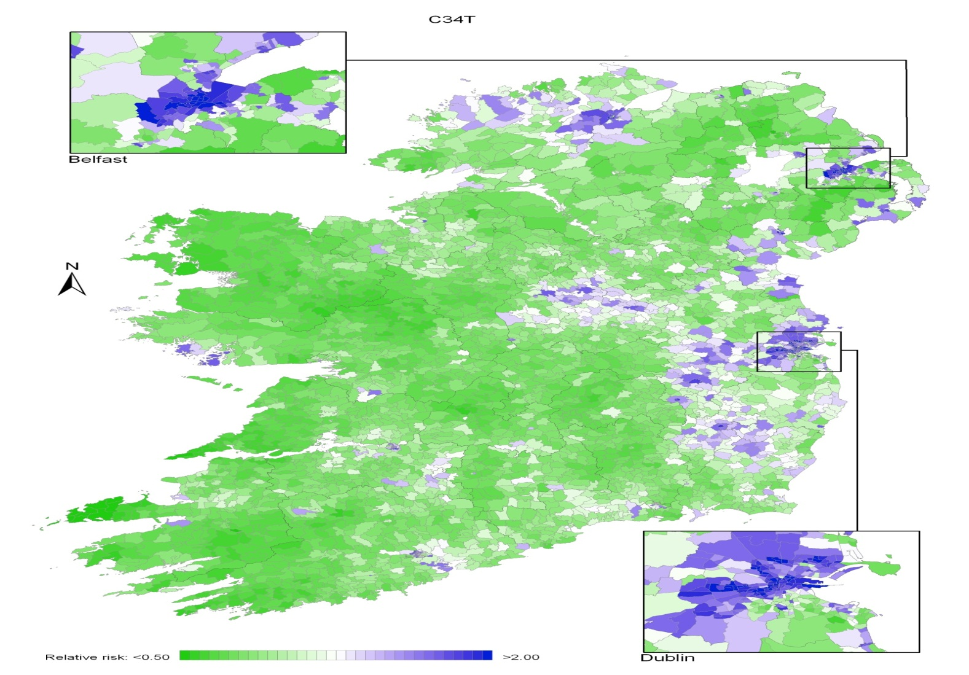
Figure 13

Slide 51
Figure 14

Slide 52
Figure 15
Notes:
Anything that can go wrong will go wrong

Slide 53
Figure 16

Slide 54
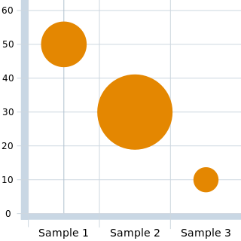
Figure 17

Slide 55
Useful Data Sources
cso.ie
https://libguides.ucd.ie/gisguide/FindSpatialData

